Slide 1
nat5 GRAPHIC COMMUNICATION
The 3P’s

Slide 2
Learning intentions & success criteria
Learning Intentions
Introduction to Preliminary, Production and Promotional Graphics
Success Criteria
Be able to recognise preliminary, production and promotional graphics.
Explain the difference between the different graphics
Describe the advantages and disadvantages of the different graphics

Slide 3
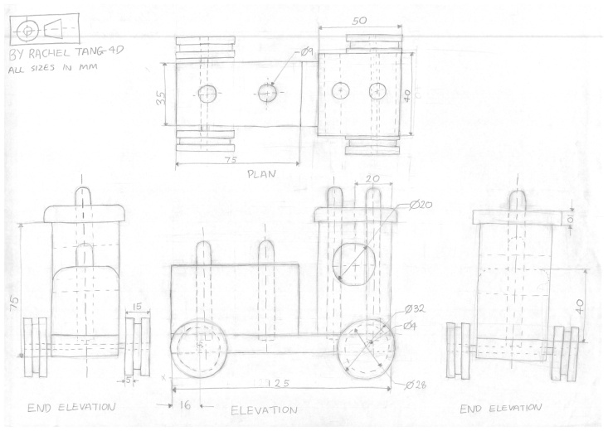
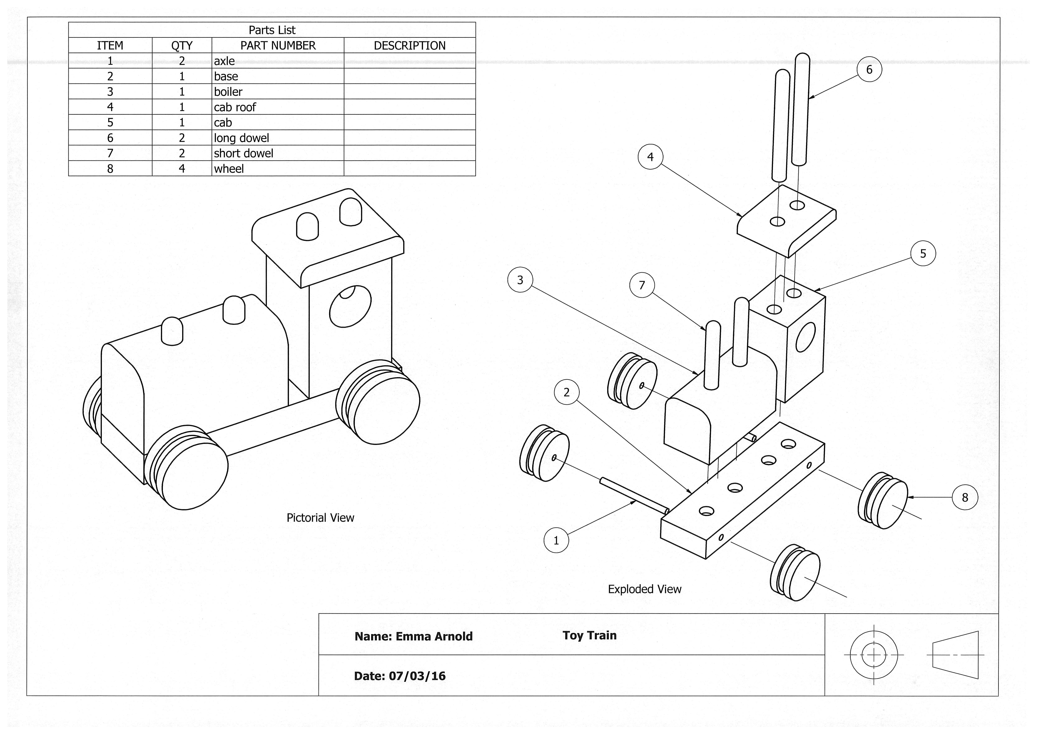
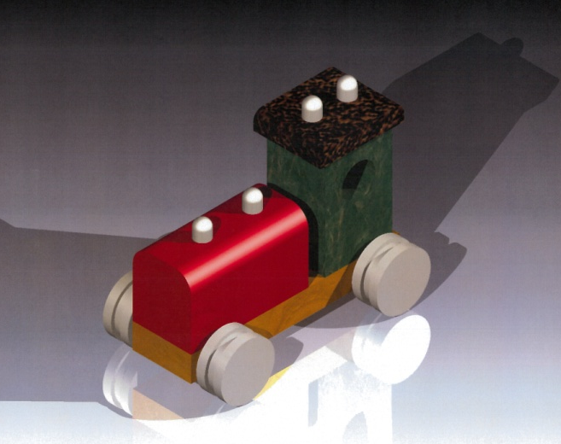
Introduction
Graphic Communication is all about communicating information. This may be in the form of a design idea for a new product, or a building plan for a new house, or a poster for use in a marketing campaign.
In industry, there are three main types of graphic that are used to present this information and these are known as the “three P’s”:
Preliminary
Production
Promotional
You will learn about and produce each type of graphic during your graphic communication course. And you may be examined on the knowledge gained in the SQA exam.

Slide 4
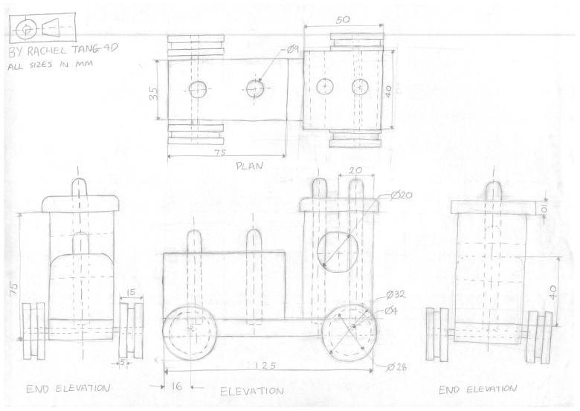
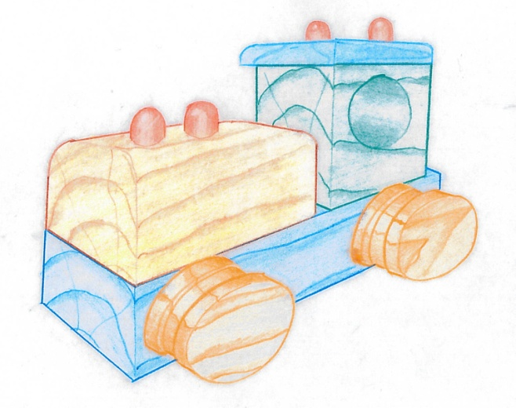
Preliminary Graphics
Preliminary Graphics
Preliminary graphics are sketches, illustration, modelling plans and thumbnail layouts used at the design stage of new product, new building and new publications. Skills in sketching, drawing and rendering are important.
Advantages
They are quick to produce
They are a good way of recording initial ideas or designs
They are a good way of developing a design
They are used to communicate information/design ideas to a client
They form the basis for production drawings
Disadvantages
They are not drawn to scale
They are not normally dimensionally accurate.

Slide 5
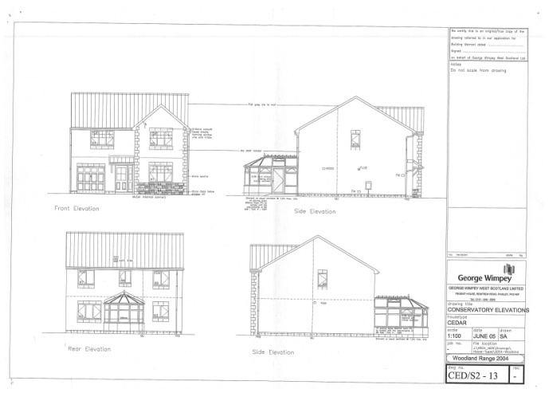
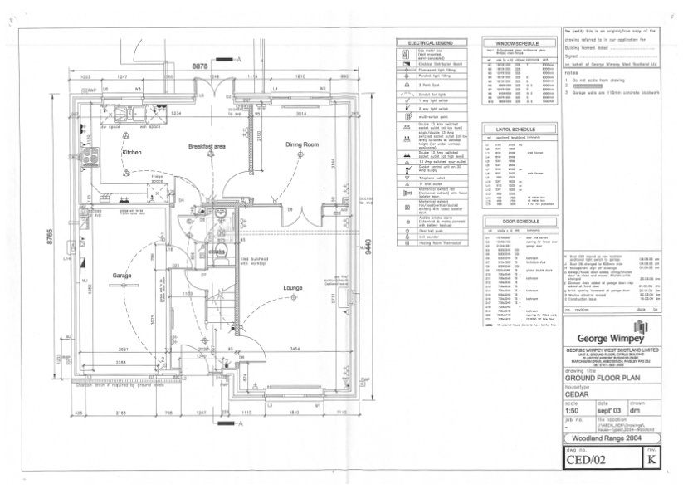
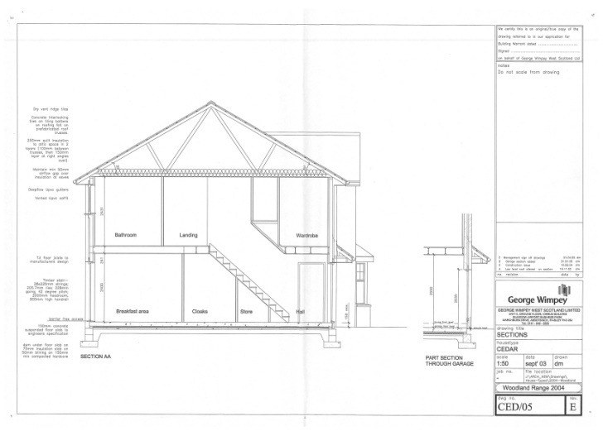
Production graphics
Production Drawings
Production Drawings generally provide precise information about the manufacture or construction of a product or project. The graphics are mainly in the form of orthographic, exploded, assembly, location, construction or dimensioned views. The main purpose of these drawings is to allow a product to manufacture accurately.
Advantages
They are important when component parts are to me manufactured.
They show how components are assembled
They can be easily dimensioned
The drawing standards used are now worldwide standards
They are accurate
They are drawn to scale
Disadvantages
Training or knowledge is required to produce them: drawing standards have to be learned
They can be time consuming to produce
Costly specialist equipment is required: drawing boards and tools or computers and appropriate software.

Slide 6
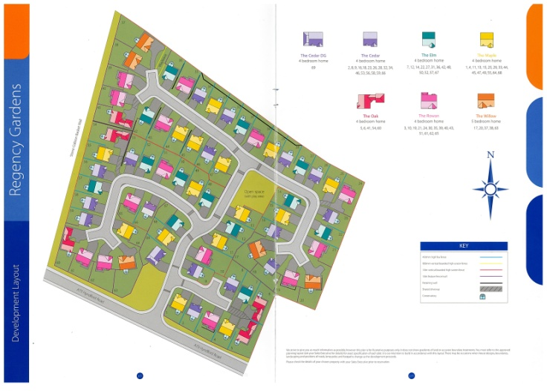
Promotional graphics
Promotional graphics are illustrative graphics and written material which will bring peoples attention to or highlight specific features/aspects of a product or project.
These may be used for sales promotion (posters and leaflets), technical promotions/illustrations etc. These illustrations and presentation techniques may be done manually, but will normally be by computer using DTP and 3D modelling software.
Advantages
They appear less “technical” than production drawings
They tend to be more easily understood
They can be made to look more realistic than production drawings
They can be used in promotional documents or videos
They can show the customer what the product or building will look like
They can have materials and lights applied to create visual impact
They can be made to look attractive in order to help sell the product.
Disadvantages
They require skill and knowledge to produce
They can give a false impression of the product
You can’t physically handle a rendered model.

